Slide 1

4
Ready Notes
For in-class note taking, choose Handouts or Notes Pages from the print options, with three slides per page.

Slide 2

The Ethical and Social Environment
Individual Ethics in Organizations
Ethics: an individual’s personal beliefs about whether a behavior, action, or decision is right or wrong.
Ethical behavior: conforms to generally accepted social norms.
Unethical behavior: does not conform to generally accepted social norms.

Slide 3
Moral and Personal Development
There are three stages:
Stage
3
Stage
2
Stage
1
POSTESTABLISHING:
Individual follows
self-chosen principles of what is justice and right. Is also aware the others have different values and
seeks solutions to ethical Dilemmas.
ESTABLISHING:
Person lives up to
Expectations of others. Fulfills duties & obligations of social system, & lives within the guidelines of the law.
BEGINNING:
Follows rules to avoid punishment. Acts in own interest. Obedience for
ones own sake.

Slide 4
Managerial Ethics
Standards of behavior that guide individual managers in their work.
Three Basic Areas of Concern:
Managers need to approach the following from an ethical and moral perspective:
  Relationships of the firm to the employees.
  The employees to the firm.
  The firm to other economic agents.

Slide 5
How an Organization Treats Its Employees
Important areas of managerial ethics include:
  Hiring.
  Firing.
  Wages.
  Working conditions.
  Employee privacy.
  Employee respect.
  How an Employee Treats Organization
Especially in regard to:
  Conflicts of interest.
  Security.
  Confidentiality.
  Honesty.
Most companies have policies that guard against violation of these ethical issues.

Slide 6
How Employees and Organization Treat Other Economic Agents
Ethics play a part in the relationship between the firm and its employees with other economic agents.
Behaviors between the organization and these agents that may be subject to ethical ambiguity include:
  Advertising
  Promotions
  Financial disclosures
  Purchasing
  Shipping
  Solicitation
  Bargaining
  Negotiation, and other business relationships.

Slide 7
Managing Ethical Behavior
Top management establishes the organization’s culture and defines what will and will not be acceptable behavior.
Code of ethics: a formal written statement of the values and ethical standards that guide a firm’s actions.

Slide 8
Managerial Ethics
Conflicts of interest,
Secrecy and
confidentiality,
Honesty
Employees
Organization
Hiring and firing,
Wages and working
conditions,
Privacy and respect
Subject to ethical ambiguities:
Advertising and promotion.
Ordering and purchasing.
Bargaining and Negotiation.
Financial disclosure.
Shipping and solicitation.
Other business relationships.
Economic Agents
Customers, Competitors, Stockholders, Suppliers, Dealers, Unions

Slide 9
Ethical Issues in Information Technology
Online privacy has become an issue as companies sort out the ethical and management issues.
Management can address this issue by posting privacy policies on the web.
Medical and financial data can be reviewed and corrected.

Slide 10
Social Responsibility
The set of obligations an organization has to protect and enhance the society in which it functions.
Areas of social responsibility:
  Stakeholders.
  The natural environment.
  Toward general social welfare.
  (see Figure 4.3)

Slide 11
Arguments For and Against Social Responsibility
FOR: Because organizations create many of the problems, such as air and water solution and resource depletion, they should play a major role in solving them.
AGAINST: Widening the interpretation of social responsibility will undermine the U.S. economy by detracting from basic mission of business. (see Figure 4.4)

Slide 12
Organizational Approaches to Social Responsibility
Defensive stance, in which an organization does everything that is required of it legally but nothing more.
Accommodative stance, in which an organization meets its legal and ethical obligations and also goes beyond these requirements in selected cases.
Proactive stance, in which an organization views itself as a citizen in a society and proactively seeks opportunities to contribute to that society. (see Figure 4.5)

Slide 13
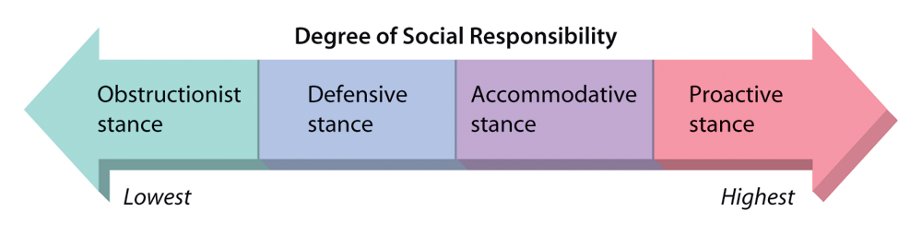
Figure 4.5: Approaches to Social Responsibility

Slide 14

The Government and Social Responsibility
Direct regulation: government attempts to influence business by establishing laws and rules that dictate what businesses can and cannot do in prescribed areas.
Indirect regulation: the government can indirectly influence the social responsibility of organizations through its tax codes.

Slide 15
How Organizations Influence Government
Personal contacts: political leaders and executives travel in the same circles and may be able to contact a politician directly.
Lobbying: persons or groups to represent an organization formally.
Political action committees: created to solicit and distribute money to political candidates.
Favors: organizations sometimes rely on favors and other influence tactics to gain support.

Slide 16
Managing Social Responsibility
Legal compliance: the extent to which an organization complies with local, state, federal, and international laws.
Ethical compliance: an organization and its members follow basic ethical (and legal) standards of behavior.
Philanthropic giving: awarding of funds or gifts to charities or other social programs.
Whistle-Blowing: the disclosure by an employee of illegal or unethical conduct on the part of others within the organization.

Slide 17
Organizational Stakeholders
State/federal government
Suppliers
Foreign government
Creditors
Customers
Local community
Local government
The
Organization
Trade associations
Interest groups
Employees
Colleges and universities
Courts
Owners/investors

